Slide 1
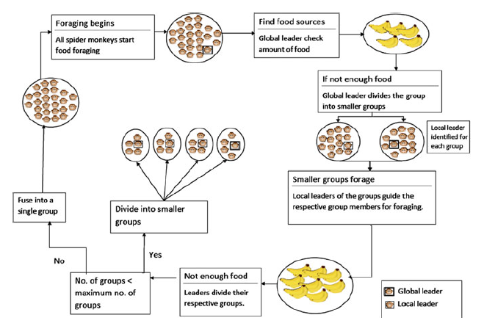
Spider monkey
概念:
蜘蛛猴生活在一個大約 40-50 隻的群體中
該群體中的所有個體都以不同的方式外出覓食，白天指路，晚上分享覓食心得
領頭的雌蛛猴會決定覓食路線
如果群體沒有找到足夠的食物，那麼她會將小組分成更小的小組分別覓食。
Notes:
蜘蛛猴生活在中美洲和南美洲的熱帶雨林中， 遠至墨西哥北部。蜘蛛猴是那邊最聰明的猴子
它們是群體動物 會根據食物的稀缺性或可用性，分裂或合併。他們之間會用手勢/吶喊進行交流

Slide 2
Spider monkey
步驟:
本地領導階段 (Local Leader Phase)
全球領導階段 (Global Leader Phase)
全球學習階段 (Global Learning Phase)
本地學習階段 (Local Learning Phase)
本地決策階段 (Local Leader Decision Phase)
全球決策階段 (Global Leader Decision Phase)

Slide 3
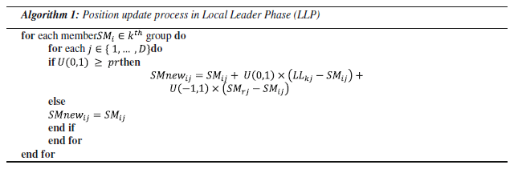
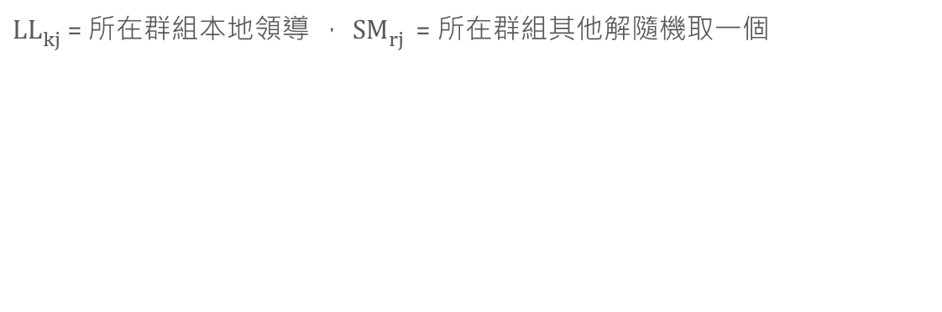
Spider monkey
1. 本地領導階段 (Local Leader Phase) :
${LL}_{kj}^{}$= 所在群組本地領導 ， ${SM}_{rj}^{}$= 所在群組其他解隨機取一個

Slide 4
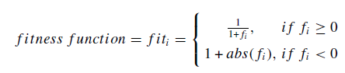
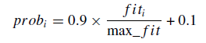
Spider monkey
2. 全球領導階段 (Global Leader Phase)
計算適應值
計算更新率

Slide 5
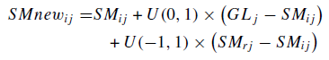
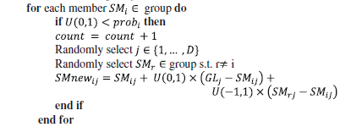
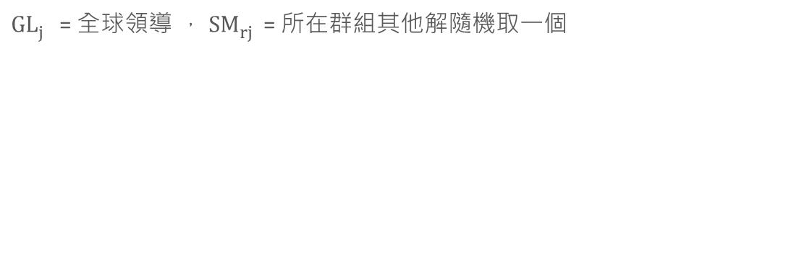
Spider monkey
2. 全球領導階段 (Global Leader Phase)
${GL}_{j}^{}$= 全球領導 ， ${SM}_{rj}^{}$= 所在群組其他解隨機取一個

Slide 6
Spider monkey
3.全球學習階段 (Global Learning Phase)
Global Limit Count 全球限制計數器 / Global Leader Limit 全球領導限制
If ( new global leader value < global leader value )
更新全球領導
Global Limit Count =0
Else
Global Limit Count = Global Limit Count +1

Slide 7
Spider monkey
4.本地學習階段 (Global Learning Phase)
Local Limit Count 全球限制計數器 / Local Leader Limit 本地領導限制
If ( new local leader value < local leader value )
更新本地領導
Local Limit Count =0
Else
Local Limit Count = +1

Slide 8
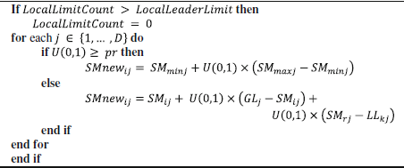
Spider monkey
5.本地決策階段 (Local Leader Decision Phase)

Slide 9
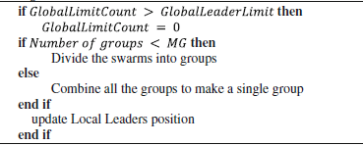
Spider monkey
6.全球決策階段 (Global Leader Decision Phase)

Slide 10
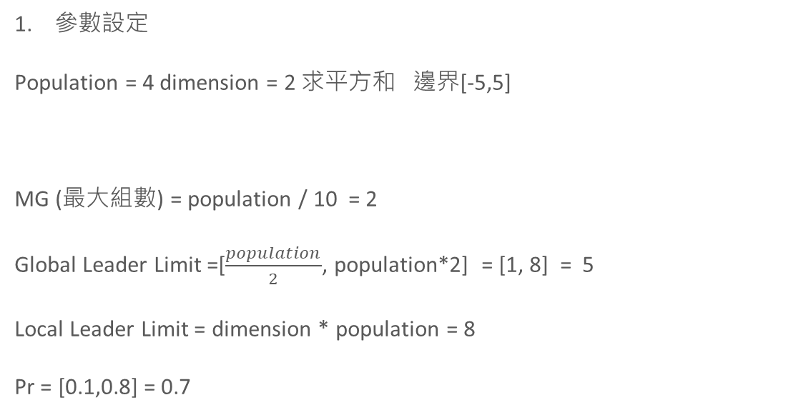
Spider monkey
參數設定
Population = 4 dimension = 2 求平方和 邊界[-5,5]
MG (最大組數) = population / 10 = 2
Global Leader Limit =[$\frac{population}{2}$, population*2] = [1, 8] = 5
Local Leader Limit = dimension * population = 8
Pr = [0.1,0.8] = 0.7

Slide 11
Spider monkey
2. 初始化
A | 3 | -2
B | 1 | 4
C | 0 | -3
D | -4 | 2
A_value | 13
B_value | 17
C_value | 9
D_value | 20
Local_Leader | 0 | -3
Local_Leader_value | 9 | 4
Global_Leader | 0 | -3
Global_Leader_value | 9 | 2

Slide 12
Spider monkey
3.本地領導階段 (Local Leader Phase)
A | 3 | -2
B | 1 | 4
Local_Leader | 0 | -3
Local_Leader_value | 9 | 4
A進行更新
隨機選擇同一組的其中一解
Dimension =0 Random=0.6 !> pr new_A[0] = A[0] =3
Dimension =1 Random=0.8 > pr new_A[1] = -2 + 0.5*(-3 – (-2)) + 0.5*(4-(-2)) = -1.5

Slide 13
Spider monkey
3.本地領導階段 (Local Leader Phase)
A | 3 | -2
New_A | 3 | -1.5
A_value | 13
New_A_value | 11.25
New_A_value < A_value
A = New_A
A_value = New_A_value

Slide 14
Spider monkey
3.本地領導階段 (Local Leader Phase)
 | Dimension |  | Value
A | 3 | -1.5 | 11.25
B | 1 | 3 | 10
C | 0 | -3 | 9
D | 2 | 0 | 4
Local_Leader | 0 | -3
Local_Leader_value | 9 | 4
Global_Leader | 0 | -3
Global_Leader_value | 9 | 2

Slide 15
Spider monkey
4.全球領導階段 (Global Leader Phase)
 | Dimension |  | Value | fitness | prob
A | 3 | -1.5 | 11.25 | 0.08 | 0.46
B | 1 | 3 | 10 | 0.09 | 0.505
C | 0 | -3 | 9 | 0.1 | 0.55
D | 2 | 0 | 4 | 0.2 | 1

Slide 16
Spider monkey
4.全球領導階段 (Global Leader Phase)
更新A
Random.random < prob_A
隨機選擇dimension 假設選到 第0個
隨機選擇同一組的其中一解
new_A[0] = 3 + 0.5*(0-3) + 0.5*(1-3) = 0.5
new_A = [0.5,-1.5]
A | 3 | -1.5
B | 1 | 3
Global_Leader | 0 | -3
Global_Leader_value | 9 | 4

Slide 17
Spider monkey
4.全球領導階段 (Global Leader Phase)
 | Dimension |  | Value
A | 0.5 | -1.5 | 11.25
B | 1 | 3 | 10
C | 0 | -3 | 9
D | 1 | 0 | 1
Local_Leader | 0 | -3
Local_Leader_value | 9 | 4
Global_Leader | 0 | -3
Global_Leader_value | 9 | 2

Slide 18
Spider monkey
5.全球學習階段 (Global Learning Phase)
new_Global_Leader_value < Global_Leader_value
Global_Leader_value = new_Global_Leader_value
Global limit count = 0
 | Dimension |  | Value
A | 0.5 | -1.5 | 11.25
B | 1 | 3 | 10
C | 0 | -3 | 9
D | 1 | 0 | 1
Local_Leader | 0 | -3
Local_Leader_value | 9 | 4
Global_Leader | 0 | -3
Global_Leader_value | 9 | 2
Local_Leader | 0 | -3
Local_Leader_value | 9 | 4
Global_Leader | 1 | 0
Global_Leader_value | 1 | 2

Slide 19
Spider monkey
6.本地學習階段 (Local Learning Phase)
new_Local_Leader_value < Local_Leader_value
Local_Leader_value = new_Local_Leader_value
Local limit count = 0
 | Dimension |  | Value
A | 0.5 | -1.5 | 11.25
B | 1 | 3 | 10
C | 0 | -3 | 9
D | 1 | 0 | 1
Local_Leader | 0 | -3
Local_Leader_value | 9 | 4
Global_Leader | 1 | 0
Global_Leader_value | 1 | 2
Local_Leader | 1 | 0
Local_Leader_value | 1 | 4
Global_Leader | 1 | 0
Global_Leader_value | 1 | 2

Slide 20
Spider monkey
7.本地決策階段 (Local Decision Phase)
Local limit count = 0 < Local Leader Limit 不執行

Slide 21
Spider monkey
8.全球決策階段 (Global Decision Phase)
假設 Global limit count = Global Leader Limit = 5
Global limit count = 0
if group < MG (分割)
group =group +1
If group ==MG (融合)
group=1

Slide 22
Spider monkey
8.全球決策階段 (Global Decision Phase)
 | Dimension |  | Value
A | 0.5 | -1.5 | 11.25
B | 1 | 3 | 10
Group1 | Local_Leader | 1 | 3
 | Local_Leader_value | 10 | 4
Group2 | Local_Leader | 1 | 0
 | Local_Leader_value | 1 | 2
 | Dimension |  | Value
C | 0 | -3 | 9
D | 1 | 0 | 1
Global_Leader | 1 | 0
Global_Leader_value | 1 | 2

Slide 23
testfunction
 |  | Dimension=30
 |  | AOA | GA | PSO | SMO | SMO 最小值
F1 |  | 6.67E-07 | 1.03E+03 | 1.83E+04 | 4.92E-13 | 2.97E-14
F2 |  | 0.00E+00 | 2.47E+01 | 3.58E+02 | 1.95E-06 | 8.88E-07
F3 |  | 6.87E-06 | 2.65E+04 | 4.05E+04 | 7.12E+03 | 3.83E+03
F4 |  | 1.40E-03 | 5.17E+01 | 4.39E+01 | 5.29E+00 | 2.47E+00
F5 |  | 2.49E+01 | 1.95E+04 | 1.96E+07 | 7.59E+01 | 1.51E+01
F6 |  | 3.47E-04 | 9.01E+02 | 1.87E+04 | 6.84E-13 | 3.02E-14

Slide 24
testfunction
 |  | Dimension=30
 |  | AOA | GA | PSO | SMO | SMO 最小值
F7 |  | 3.92E-06 | 1.91E-01 | 1.07E+01 | 4.96E-02 | 1.98E-02
F8 |  | -1.22E+04 | -1.26E+04 | -3.86E+03 | -1.64E+16 | -4.65E+17
F9 |  | 3.42E-07 | 9.04E+00 | 2.87E+02 | 6.01E+01 | 4.56E+01
F10 |  | 8.88E-16 | 1.36E+01 | 1.75E+01 | 4.78E-08 | 9.98E-09
F11 |  | 0.00E+00 | 1.01E+01 | 1.70E+02 | 1.00E+00 | 1.00E+00

